Slide 1


HTML/CSS
Personal Landing Page
Fred

Slide 2

01.
Setup
02.
Coding Language
Contents
03.
Code
04.
Landing Page

Slide 3

PART.01
Setup
Compiler & Browser

Slide 4


Setup
Sublime Text 3
Chrome

Slide 5
PART.02
Coding Language
HTML & CSS & Java Script

Slide 6
Coding Language
HTML
CSS
JS
Content & Structure
Style
Dynamism & Usability

Slide 7
HTML
HTML (HyperText Markup Language) is the most basic building block of the Web. It describes and defines the content of a webpage along with the basic layout of the webpage.

Slide 8
PART.03
Code
Your First HTML File

Slide 9
Your First HTML File
1
2
3
New Folder
New File
Code
Open folder in Sublime
Ctrl + S then name it
Input“html”then Tab

Slide 10
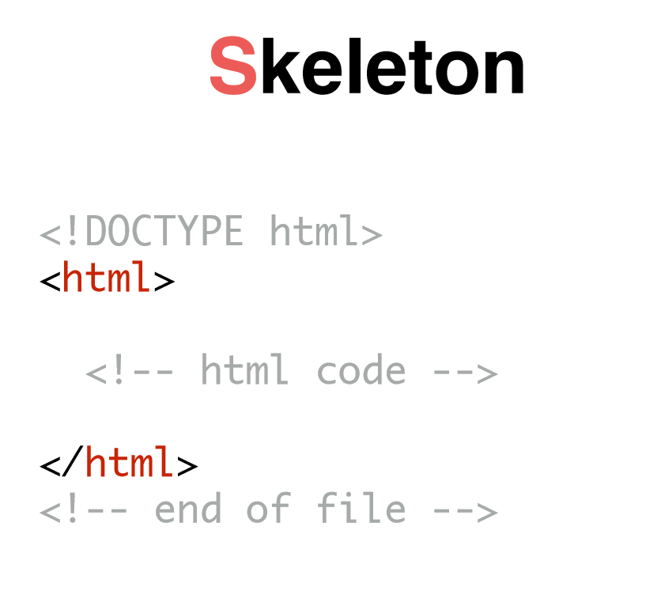
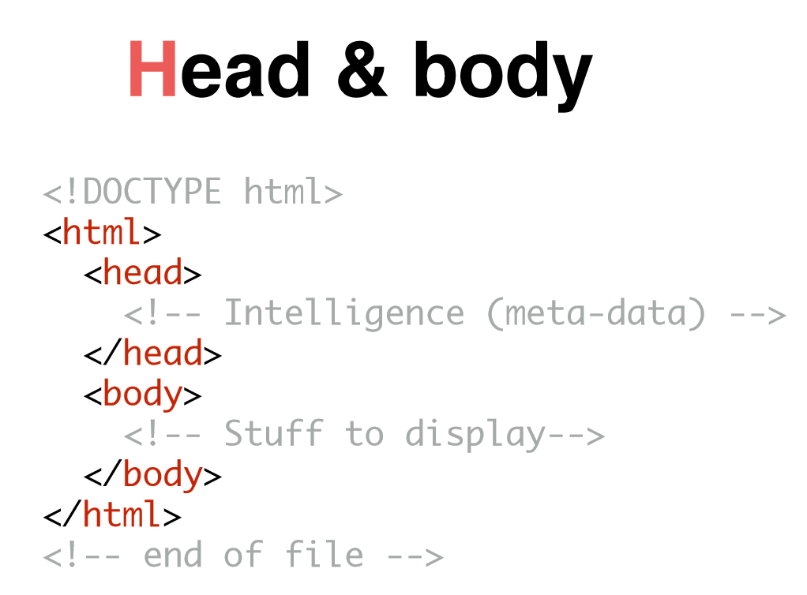
Structure

Slide 11
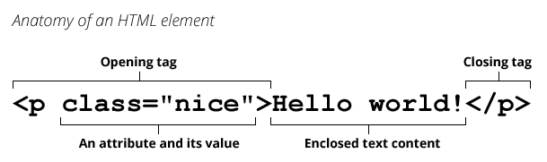

Slide 12
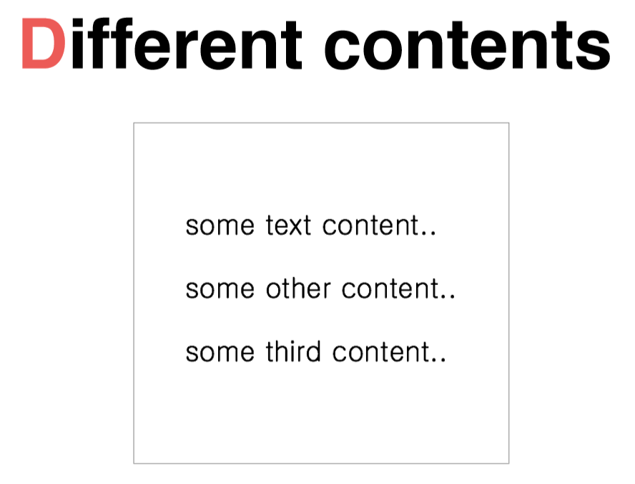
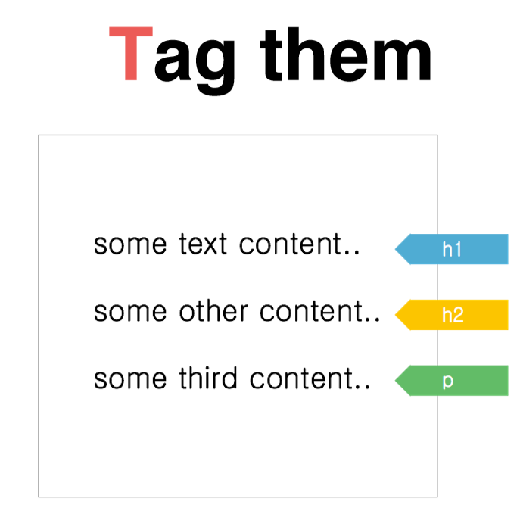
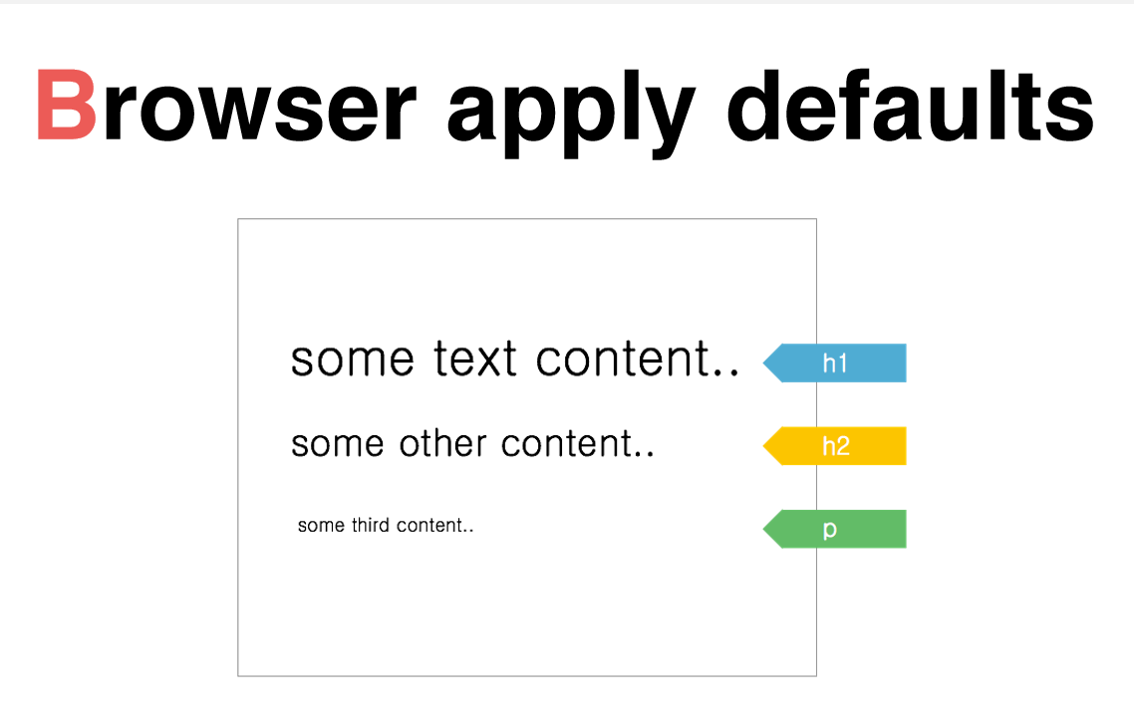
Tag

Slide 13
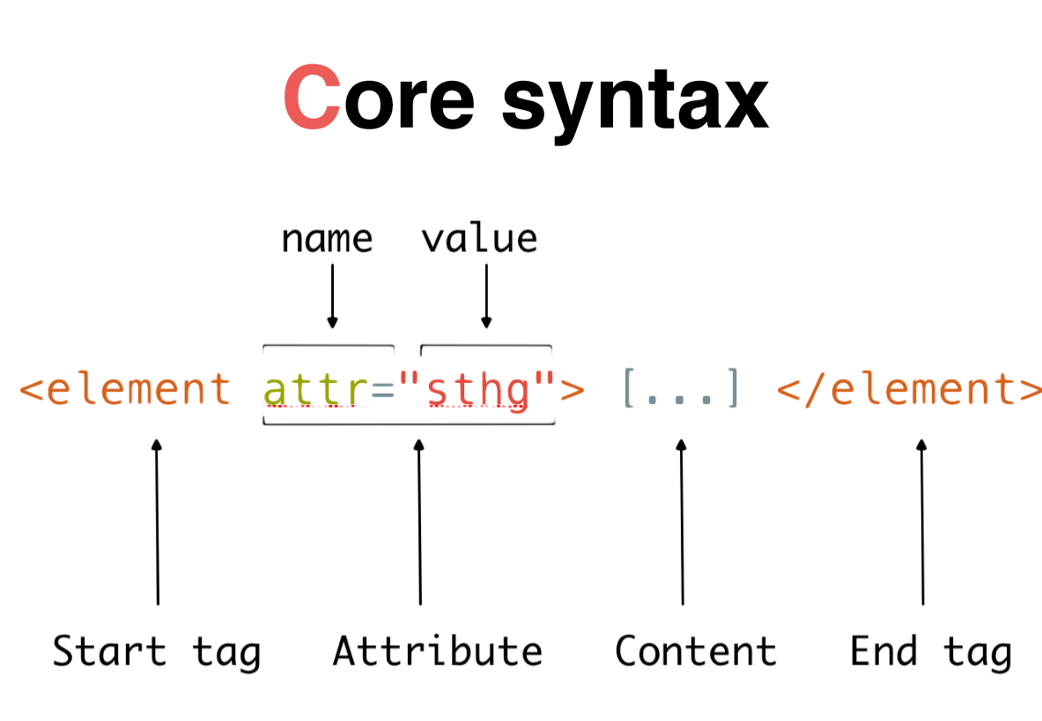

Slide 14
The kinds of Tag
images:<img src="">
<h1></h1>:title
link:<a href=""></a>
<p></p>: paragraph
list:<li></li>
<video></video>:video <audio></audio>:audio

Slide 15
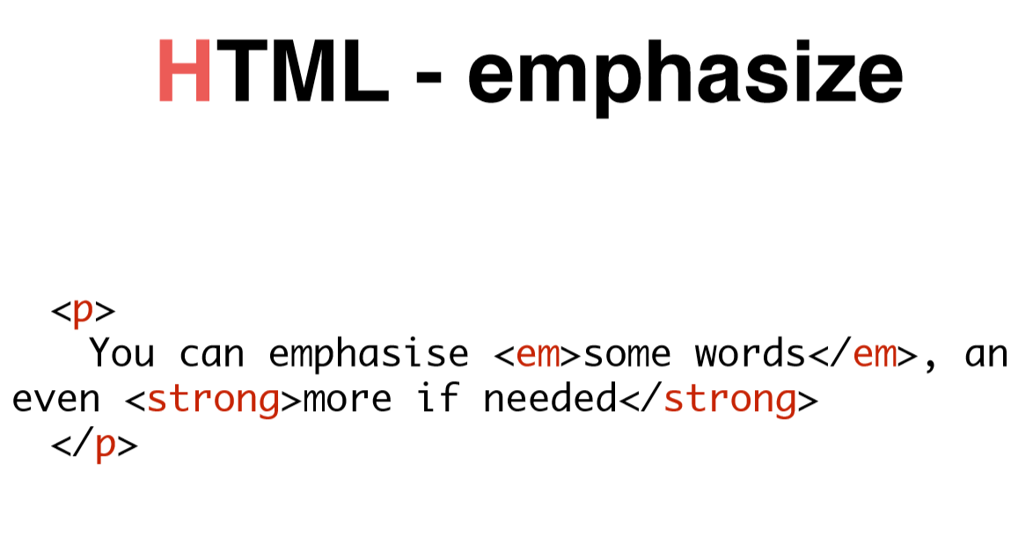
Emphasize

Slide 16
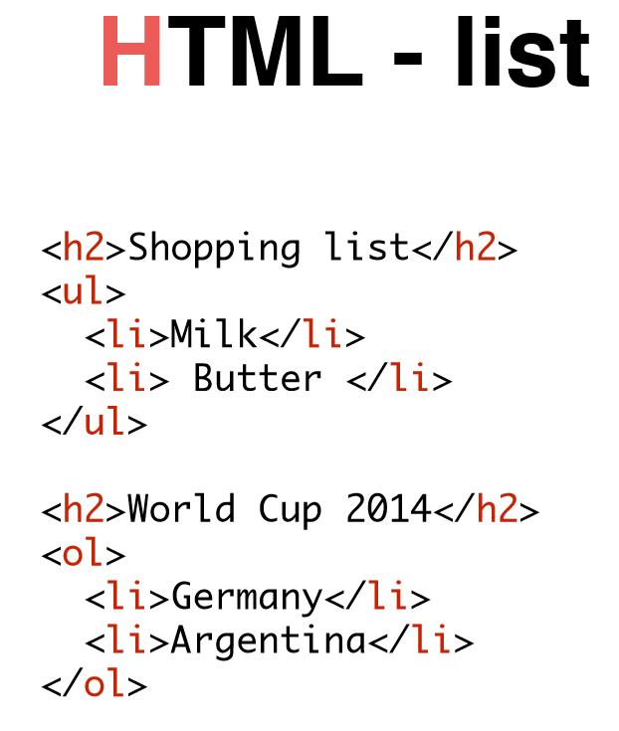
List

Slide 17
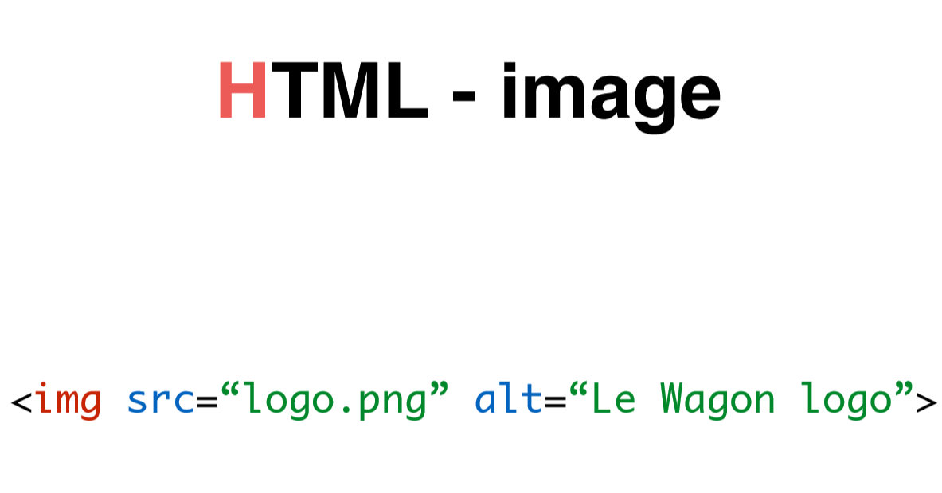
Image

Slide 18
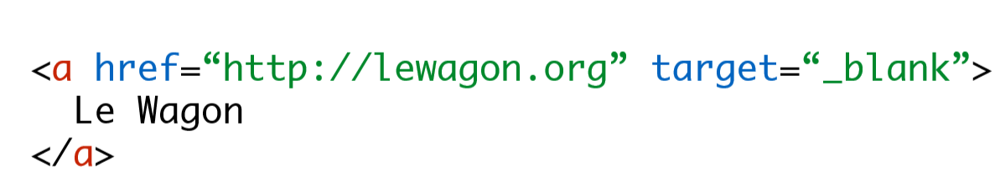
Link

Slide 19
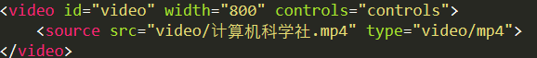
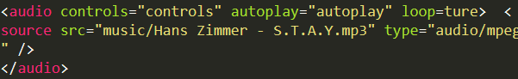
Video/Audio

Slide 20
THANK YOU
Powered by Fred

Slide 21
CSS

